Slide 1
Introduction to Databases CT042-3-1-IDB (version1)
Week 5: Relational Database
(Part 2)

Slide 2
Topic & Structure of The Lesson
Relationship within the relational model
1:1
1:M
M:N
Resolving M:N relationship

Slide 3
Learning Outcomes
At the end of this topic, You should be able to
Construct a simple relational model

Slide 4
Key Terms You Must Be Able To Use
If you have mastered this topic, you should be able to use the following terms correctly in your assignments and exams:
1:1
1:M
M:N

Slide 5
Relationships within the Relational Database
1:M relationship
Relational modeling ideal
Should be the norm in any relational database design
1:1 relationship
Should be rare in any relational database design
M:N relationships
Cannot be implemented as such in the relational model
M:N relationships can be changed into two 1:M relationships

Slide 6
The 1:M Relationship
Relational database norm
Found in any database environment

Slide 7
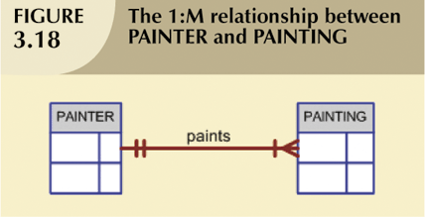
The 1:M Relationship (continued)

Slide 8
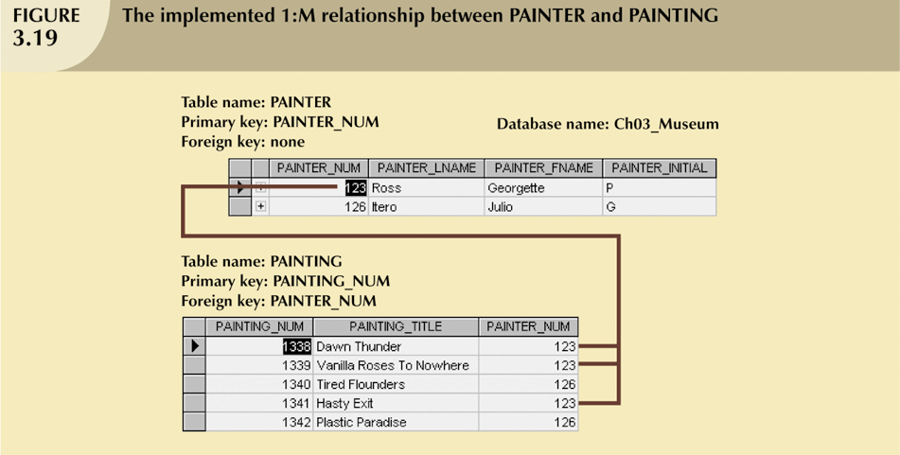
The 1:M Relationship (continued)

Slide 9
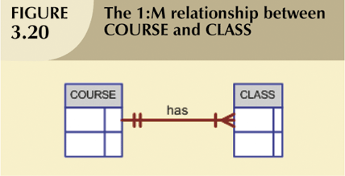
The 1:M Relationship (continued)

Slide 10
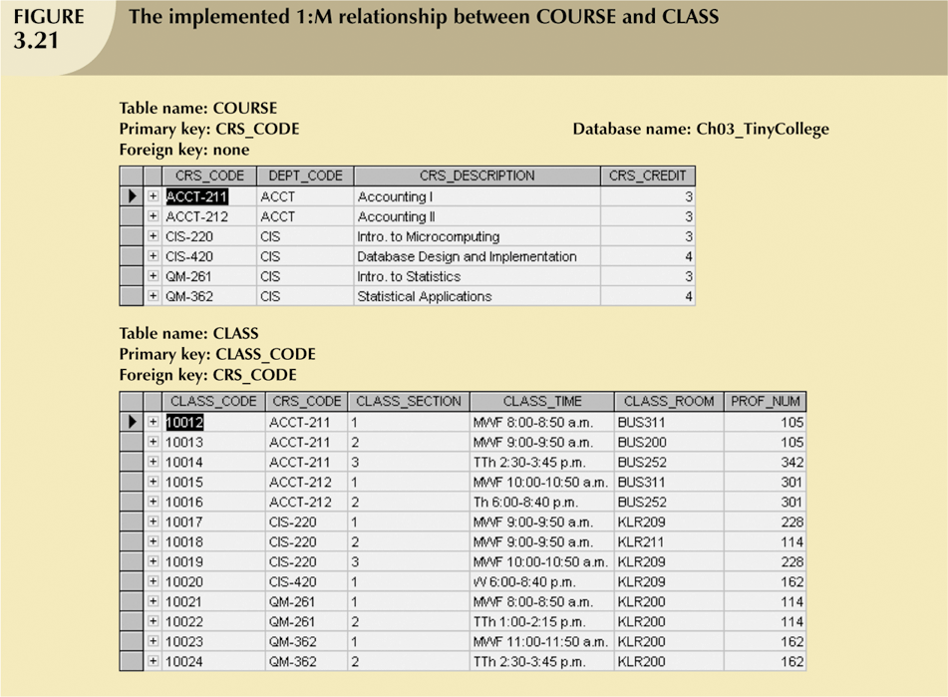
The 1:M Relationship (continued)

Slide 11
The 1:1 Relationship
One entity can be related to only one other entity, and vice versa
Sometimes means that entity components were not defined properly
Could indicate that two entities actually belong in the same table
As rare as 1:1 relationships should be, certain conditions absolutely require their use

Slide 12
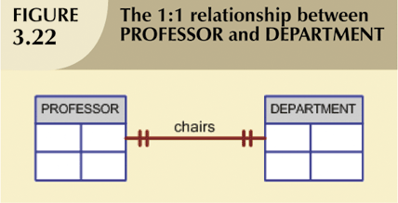
The 1:1 Relationship (continued)

Slide 13
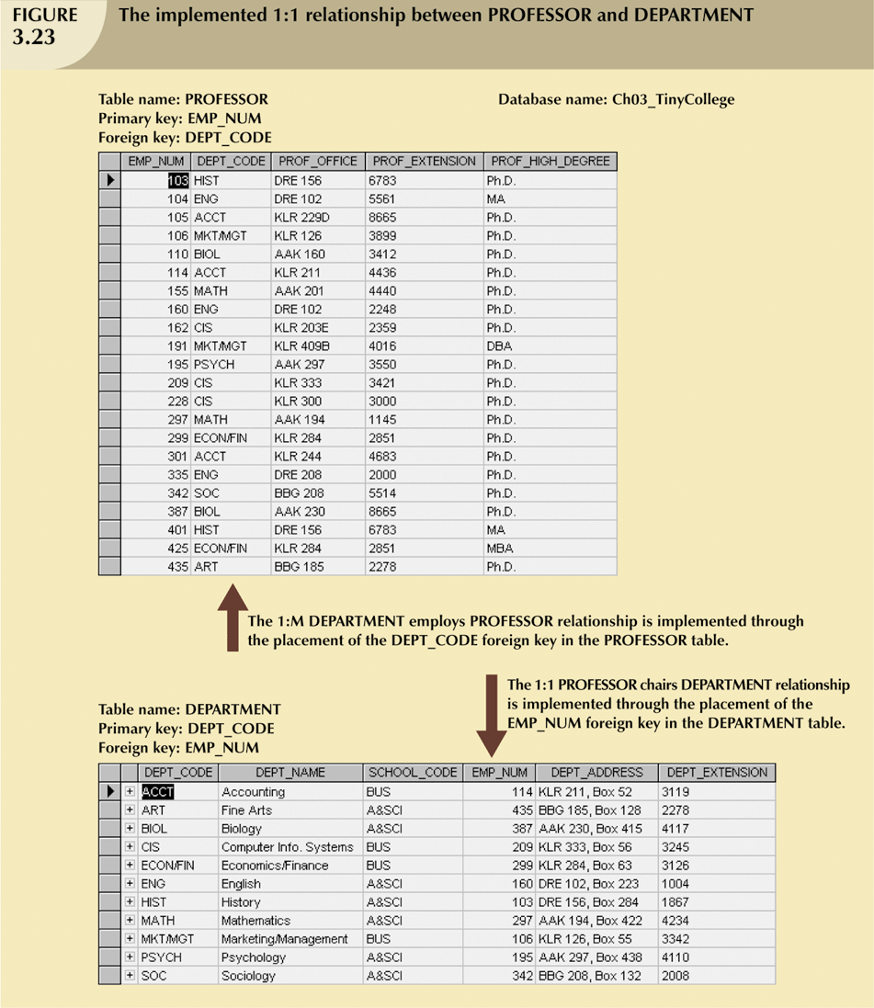
The 1:1 Relationship (continued)

Slide 14
The M:N Relationship
Can be implemented by breaking it up to produce a set of 1:M relationships
Can avoid problems inherent to M:N relationship by creating a composite entity or bridge entity

Slide 15
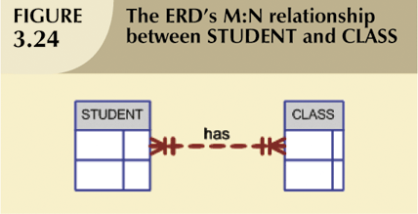
The M:N Relationship (continued)

Slide 16
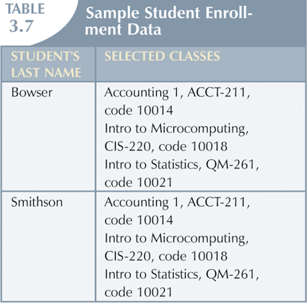
The M:N Relationship (continued)

Slide 17
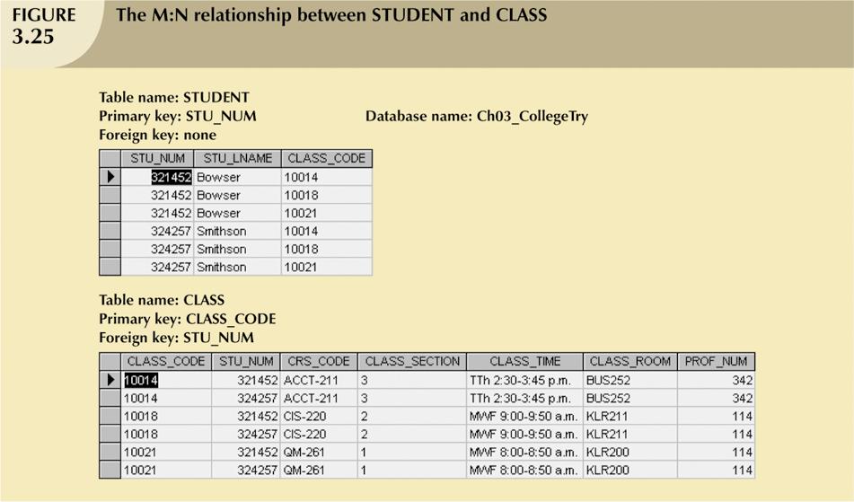
The M:N Relationship (continued)

Slide 18
The M:N Relationship (continued)
Implementation of a composite entity
Yields required M:N to 1:M conversion
Composite entity table must contain at least the primary keys of original tables
Linking table contains multiple occurrences of the foreign key values
Additional attributes may be assigned as needed

Slide 19
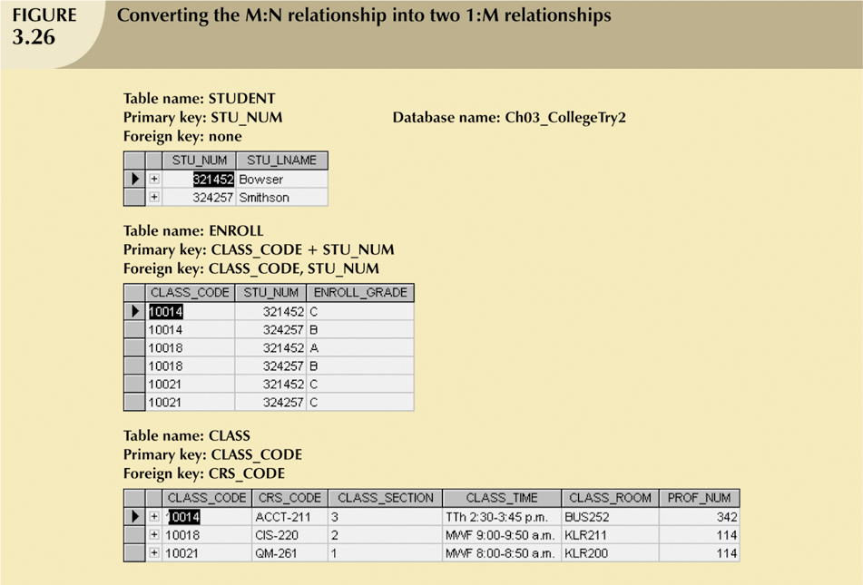
The M:N Relationship (continued)

Slide 20
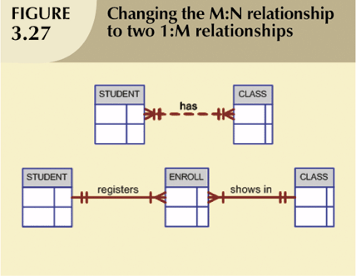
The M:N Relationship (continued)

Slide 21
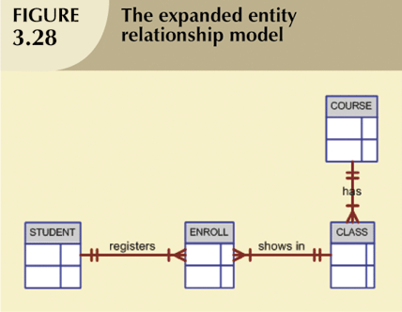
The M:N Relationship (continued)

Slide 22
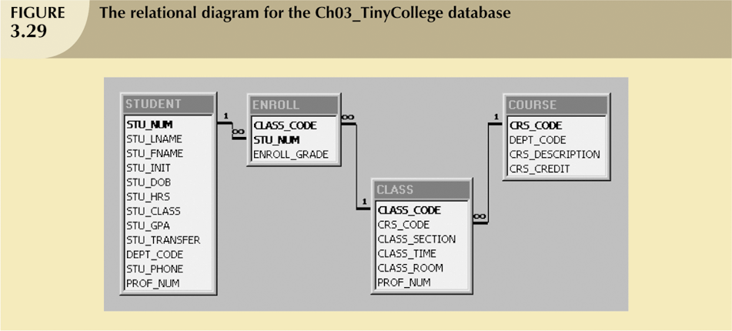
The M:N Relationship (continued)

Slide 23
Data Redundancy Revisited
Data redundancy leads to data anomalies
Such anomalies can destroy the effectiveness of the database
Foreign keys
Control data redundancies by using common attributes shared by tables
Crucial to exercising data redundancy control
Sometimes, data redundancy is necessary

Slide 24

Data Redundancy Revisited (continued)

Slide 25
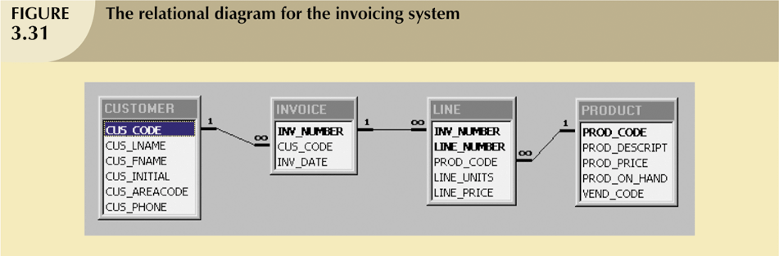
Data Redundancy Revisited (continued)

Slide 26
Quick Review Question
Provide 1 example each for the type of relationship below:
1:1
1:M
M:N
Explain how to resolve M:N relationship using the example above

Slide 27
Summary of Main Teaching Points
Each table row must have a primary key which uniquely identifies all attributes
Tables can be linked by common attributes. Thus, the primary key of one table can appear as the foreign key in another table to which it is linked
Good design begins by identifying appropriate entities and attributes and the relationships among the entities. Those relationships (1:1, 1:M, and M:N) can be represented using ERDs.

Slide 28
Question and Answer Session
Q & A

Slide 29
What we will cover next
Components of ER model
Types of attributes
Connectivity and Cardinality

